Slide 1
Heaps

Slide 2
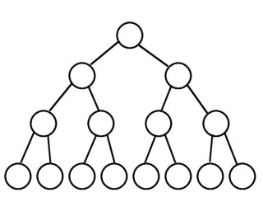
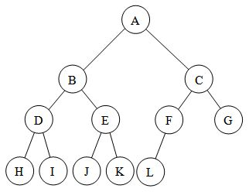
Full v.s. Complete Binary Trees
A full binary tree is a binary tree in which each node has exactly 0 or 2 children.
A complete binary tree is a binary tree in which every level, except possibly the last, is completely filled, and all nodes are as far left as possible

Slide 3
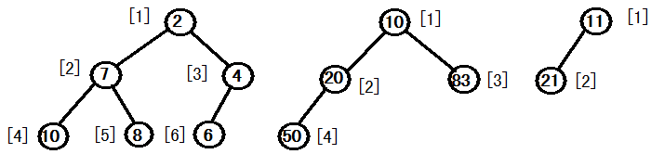
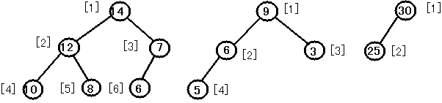
Binary Heap: Definition
(1) A complete binary tree filled on all levels, except last, which is filled from left to right. Not a binary search tree, but the keys do follow some order.
(2) Heap property
(a) Min-heap: every child greater than (or equal to) parent (A[Parent(i)] <=A[i])
(b) Max-heap: every child smaller than (or equal to) parent (A[Parent(i)] >=A[i])

Slide 4
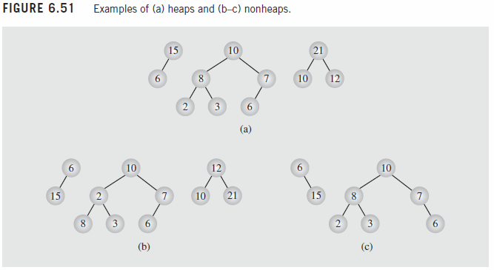
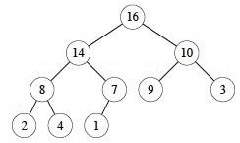
Binary Heap
Max or min element is in root ( e.g., b1 is not max-heap)
Heap with N elements has height = ⎣log₂ N⎦.
Examples of priority queue
Printer
Important document → max-heap
Short documents → min-heap (e.g., 1 page vs 100 page)
N = 10 Height = 3

Slide 5
Heap Implementation
Several ways to implement heaps/priority queues
Linked list: fast insertion at the front but delete could be slow.
Sorted list: fast deletion but insertion is expensive.
Binary search tree: O(log N) for insert and delete operations
Array or vector: No nodes, no pointers and no links.
The problem with the array implementation is that an estimate of the maximum heap size is required in advance, but typically this is not a problem (and we can resize if needed).
We shall draw the heaps as trees, with the implication that an actual implementation will use simple arrays.

Slide 6
Implementing a Heap
42
We will store the data from the nodes in a partially-filled array.
35
23
27
21
An array of data

Slide 7
Implementing a Heap
42
Data from the root goes in the first location of the array.
35
23
27
21
42
An array of data

Slide 8
Implementing a Heap
42
Data from the next row goes in the next two array locations.
35
23
27
21
42
35
23
An array of data

Slide 9
Implementing a Heap
42
Data from the next row goes in the next two array locations.
35
23
27
21
42
35
23
27
21
An array of data

Slide 10
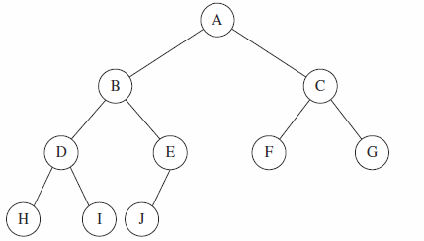
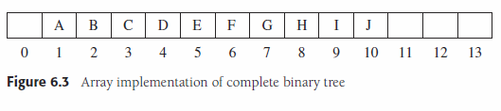
Array Implementation
For any element in array position i
If index starts from 1:
Left (i) = the left child is in position = 2i
Right (i)= the right child is in position = 2i + 1
Parent(i) = the parent is in position = ⎣i/2⎦
If index starts from 0:
Left (i) = 2i +1
Right (i)= 2i + 2
Parent(i) = ⎣(i-1)/2⎦

Slide 11
Binary Heap: Insertion
(1) Insert into next available slot.
(2) Bubble up until it's heap ordered.
The process of pushing the new node upward is called reheapification upward.
06
14
45
78
18
47
53
swap with parent
83
91
81
77
84
99
64
42
next free slot

Slide 12
swap with parent
stop: heap ordered
06
06
14
45
14
42
78
18
47
42
78
18
47
45
83
91
81
77
84
99
64
42
83
91
81
77
84
99
64
53
53

Slide 13
Binary Heap: Decrease Key
Decrease key of element x to k.
Bubble up until it's heap ordered.
06
14
42
78
18
47
45
83
91
81
77
84
99
64
53

Slide 14
Binary Heap: Delete root (min/max)
(1) Exchange root with rightmost leaf.
(2) Delete the rightmost leaf.
(3) Bubble root down until it's heap ordered.
06
14
42
78
18
47
45
83
91
81
77
84
99
64
53

Slide 15
53
53
14
42
14
42
78
18
47
45
78
18
47
45
83
91
81
77
84
99
64
06
83
91
81
77
84
99
64
14
14
stop: heap ordered
53
42
18
42
78
18
47
45
78
53
47
45
83
91
81
77
84
99
64
83
91
81
77
84
99
64

Slide 16
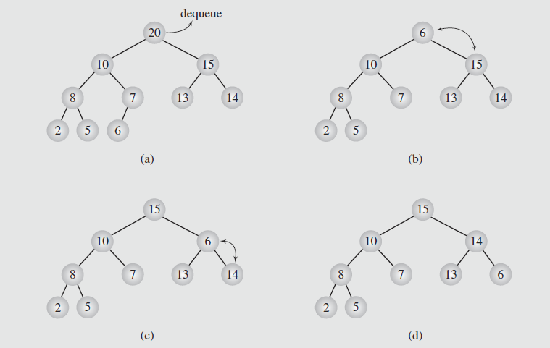
Example: delete in a max-heap

Slide 17
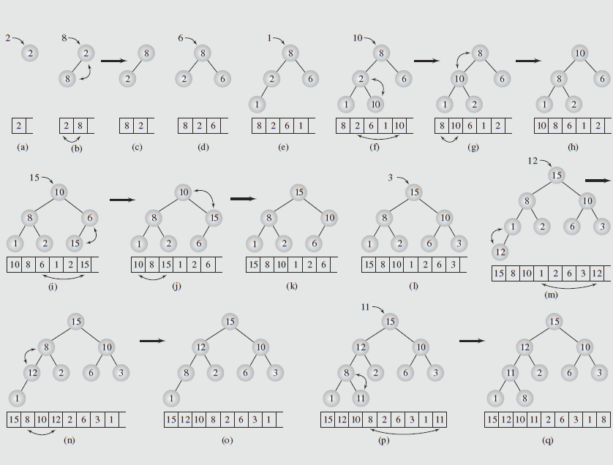
Example: Insertion to max-heap 2,8,6,1,10,15,3,12,11

Slide 18
Heapify
Max-Heapify or Heapify Down maintains heap property by “floating” a value down the heap that starts at i until it is in the correct position. If the value bubble up then it is called Min-Heapify or Heapify Up. A = Array, n = heapsize.
Max-Heapify(A,i,n)
L = Left(i)
R = Right(i)
if L <=n and A[L] > A[i]
largest = L
else largest = i
if R <= n and A[R] > A[largest]
largest = R
if largest ≠ i
exchange A[i] ↔ A[largest]
Max-Heapify(A,largest,n)
Find the largest node between the current node and its children

Slide 19
Max-Heapify Example
Heapify(A,1,10)
A=[1 13 10 8 7 6 2 4 3 5]
Next is Heapify(A,2,10)
A=[13 1 10 8 7 6 2 4 3 5]
Next is Heapify(A,4,10)
A=[13 8 10 1 7 6 2 4 3 5]
Next is Heapify(A,8,10)
A=[13 8 10 4 7 6 2 1 3 5]
On this iteration we have reached a leaf and are finished.

Slide 20
Building the Heap
Given an array A, we want to build this array into a heap.
Note: Leaves are already a heap!
Build-Max-Heap(A,n)
for i = n downto 1 // could we start at n/2?
Max-Heapify(A,i,n)
Start with the leaves (last ½ of A) and consider each leaf as a 1 element heap. Call heapify on the parents of the leaves, and continue recursively to call heapify, moving up the tree to the root.

Slide 21
Build-Heap Example
Build-Max-Heap(A,10)
A=[1 5 9 4 7 10 2 6 3 14]
Max-Heapify(A,10,10) exits since this is a leaf.
Max-Heapify(A,9,10) exits since this is a leaf.
Max-Heapify(A,8,10) exits since this is a leaf.
Max-Heapify(A,7,10) exits since this is a leaf.
Max-Heapify(A,6,10) exits since this is a leaf.
Max-Heapify(A,5,10) puts the largest of A[5]
and its children, A[10] into A[5]:

Slide 22
Build-Heap Example
A=[1 5 9 4 14 10 2 6 3 7]
Max-Heapify(A,4,10)

Slide 23
Build-Heap Example
A=[1 5 9 6 14 10 2 4 3 7]
Max-Heapify(A,3,10):

Slide 24
Build-Heap Example
A=[1 5 10 6 14 9 2 4 3 7]
Max-Heapify(A,2,10):

Slide 25
Build-Heap Example
Max-Heapify(A,2,10)
Max-Heapify(A,5,10)
Recursive call
A=[1 14 10 6 7 9 2 4 3 5]
Max-Heapify(A,1,10):

Slide 26
Build-Heap Example
Max-Heapify(A,1,10)
Max-Heapify(A,2,10)
Max-Heapify(A,5,10)
Recursive call
Recursive call
Finished heap: A=[14 7 10 6 5 9 2 4 3 1]

Slide 27
Build-Max-Heap Example 2
4
1
3
2
16
9
10
14
8
7

Slide 28
4
1
3
2
16
9
10
14
8
7

Slide 29
4
1
3
16
9
10
14
2
8
7

Slide 30
4
1
3
14
16
9
10
2
8
7

Slide 31
4
1
10
14
16
9
3
2
8
7

Slide 32
4
1
10
14
16
9
3
2
8
7

Slide 33
4
16
10
14
1
9
3
2
8
7

Slide 34
4
16
10
14
7
9
3
2
8
1

Slide 35
16
4
10
14
7
9
3
2
8
1

Slide 36
16
14
10
4
7
9
3
2
8
1

Slide 37
16
14
10
7
9
3
8
2
4
1

Slide 38
Heapsort
Once we can build a heap and heapify, sorting is easy… just remove max N times

Slide 39
Example: Heap Sort
Array interpreted as a binary tree
1 2 3 4 5 6 7 8 9 10
26 5 77 1 61 11 59 15 48 19
[1]
26
input file
[2]
5
[3]
77
[4]
1
[5]
61
[6]
11
[7]
59
[8]
15
[9]
48
[10]
19

Slide 40
Heap Sort
Adjust it to a MaxHeap
[1]
77
initial heap
[2]
61
[3]
59
[4]
48
[5]
19
[6]
11
[7]
26
[8]
15
[9]
1
[10]
5

Slide 41
Heap Sort
Exchange and adjust
[1]
77
[2]
61
[3]
59
exchange
[4]
48
[5]
19
[6]
11
[7]
26
[8]
15
[9]
1
[10]
5

Slide 42
Heap Sort
[1]
61
[2]
48
[3]
59
15
19
11
[7]
26
[4]
[5]
[6]
5
1
77
[1]
59
[8]
[9]
[10]
(a)
48
26
[2]
[3]
15
19
11
[7]
1
[4]
[5]
[6]
[8]
5
[9]
61
[10]
77
(b)

Slide 43
Heap Sort
[1]
48
[2]
19
[3]
26
15
5
11
[7]
1
[4]
[5]
[6]
59
59
61
[8]
[9]
61
[10]
77
[1]
26
(c)
[2]
19
[3]
11
48
15
5
1
[7]
48
[4]
[5]
[6]
59
[8]
59
[9]
61
[10]
77
(d)

Slide 44
Heap Sort
[1]
19
[2]
15
[3]
11
48
1
5
26
1
[4]
[5]
[6]
26
[7]
59
59
61
[8]
[9]
61
[10]
77
[1]
15
(e)
[2]
5
[3]
11
48
1
5
26
48
[4]
[5]
19
[6]
1
[7]
59
[8]
59
[9]
61
[10]
77
(f)

Slide 45
Heap Sort
[1]
11
[2]
5
[3]
1
48
15
19
26
1
[4]
1
[5]
5
[6]
26
[7]
59
59
61
[8]
[9]
61
[10]
77
[1]
5
(g)
1
11
[2]
[3]
1
48
1
5
26
48
[4]
15
[5]
19
[6]
1
[7]
59
[8]
59
[9]
61
[10]
77
(h)

Slide 46
Heap Sort
[1]
1
5
11
[2]
1
[3]
1
48
1
5
26
48
[4]
15
[5]
19
[6]
1
[7]
59
61
77
[8]
59
[9]
[10]
(i)

Slide 47
Heap Sort Example 2
Input: 4, 1, 3, 2, 16, 9, 10, 14, 8, 7.
Build a max-heap
16
14
10
7
9
3
8
2
4
1
16, 14, 10, 8, 7, 9, 3, 2, 4, 1.

Slide 48
1
14
10
7
9
3
8
2
4
16

Slide 49
1
14
10
7
9
3
8
2
4
16
1, 14, 10, 8, 7, 9, 3, 2, 4, 16.

Slide 50
14
8
10
7
9
3
4
2
1
16

Slide 51
14
8
10
7
9
3
4
2
1
16
14, 8, 10, 4, 7, 9, 3, 2, 1, 16.

Slide 52
1
8
10
7
9
3
4
2
14
16

Slide 53
1
8
10
7
9
3
4
2
14
16
1, 8, 10, 4, 7, 9, 3, 2, 14, 16.

Slide 54
10
8
9
7
1
3
4
2
14
16

Slide 55
10
8
9
7
1
3
4
2
14
16
10, 8, 9, 4, 7, 1, 3, 2, 14, 16.

Slide 56
2
8
9
7
1
3
4
10
14
16

Slide 57
2
8
9
7
1
3
4
10
14
16
2, 8, 9, 4, 7, 1, 3, 10, 14, 16.

Slide 58
9
8
3
7
1
2
4
10
14
16

Slide 59
9
8
3
7
1
2
4
10
14
16
9, 8, 3, 4, 7, 1, 2, 10, 14, 16.

Slide 60
2
8
3
7
1
9
4
10
14
16

Slide 61
8
7
3
2
1
9
4
10
14
16

Slide 62
1
7
3
2
8
9
4
10
14
16

Slide 63
7
4
3
2
8
9
1
10
14
16

Slide 64
2
4
3
7
8
9
1
10
14
16

Slide 65
4
2
3
7
8
9
1
10
14
16

Slide 66
1
2
3
4
7
8
9
10
14
16

Slide 67
3
2
1
4
7
8
9
10
14
16

Slide 68
1
2
3
4
7
8
9
10
14
16

Slide 69
2
1
3
4
7
8
9
10
14
16

Slide 70
1
2
3
4
7
8
9
10
14
16
1, 2, 3, 4, 7, 8, 9, 10, 14, 16

Slide 71
Extracting Max
Extract the maximum element from the heap:
Heap-Extract-Max(A,n) // n size of heap
if n < 1
error “heap underflow”
max = A[1]
A[1] = A[n]
n = n - 1 // decrease size of heap
Max-Heapify(A,1,n)
return max

Slide 72
Heap-Insert (A,x)
Similar idea to heapify, put new element at end, bubble up to proper place toward root
Max-Heap-Insert(A,key) // n size of heap
n <- n+1
i <- n
while i>1 and A[i/2] <key
do A[i] <- A[i/2]
i <- i/2
A[i] <- key

Slide 73
Insert Example
Insert new element “11” starting at new node on bottom, i=8
Bubble up
Bubble up once more
Stop at this point, since parent (index 1, value 14) has a larger value

Slide 74
Useful Links
Heaps, Part 1: Definition, Insertion, and Deletion https://www.youtube.com/watch?v=-6-xKgLOZPM

Slide 75
Acknowledgments
Data Structures and Algorithm Analysis in C++, Mark Allen Weiss, 4th ed, 2013. Chapter 6.
Data Structures and Algorithms in C++ (2rd ed.), Michael T. Goodrich, Roberto Tamassia, David M. Mount, 2011. Chapter 8.
Data Structures and Algorithms in C++ (4rd ed.), Adam Drozdek,2005. Chapter 6.
Data Structures with C++ Using STL 2nd, Ford, 2001. Chapter 14.
Data Abstraction & Problem Solving with C++, Carrano, 6th, 2012. Chapter 17.
Introduction to Algorithms, (3rd ed.), CLRS, 2009. Chapter 6
Dr. Kenrick Mock notes
Dr. Ding-zhu Du notes
Kevin Wayne notes
Michael Main notes
Jianye Hao notes

